Slide 1
NEWS DATA ANALYSIS – HUFFINGTON POST
ASHWATHGURU S | NOOPUR AGRAWAL
181046039 | 181046002
BDA – 1st Semester | BDA – 1st Semester
Under the guidance
of
Mr. Arokiaraj

Slide 2
INTRODUCTION

Slide 3
Data Description
JSON format
2,00,852 records
Columns : Author, Category, Date, Headline, Link, Short Description
28 – 01 – 2012 to 26 – 05 – 2018

Slide 4
DATA ENGINEERING
1. ) EXTRACTED THE FOLLOWING COLUMNS FOR MONTHY,DAY WISE AND WEEKDAY VS WEEKEND ANALYSIS:
'MONTH’
'DAY’
'DAY_OF_WEEK’
2.) APPENDED ALL THE DATA ONTO CSV FILE

Slide 5
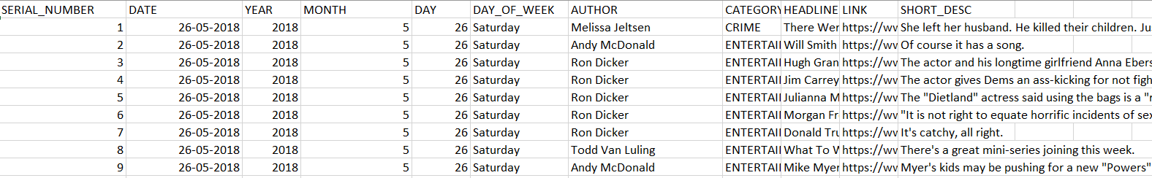
Data Preparation
Existing Columns : Author, Category, Date, Headline, Link, Short Description
NOW : in CSV

Slide 6
PROBLEM STATEMENTS – End Goals
Date to Date Analysis of Content Creation
Seasonal Analysis based on posts published
Trend Analysis – Popular Category / Popular Author
Weekday vs Weekend Analysis
Author Analysis
Category Prediction on the basis on headline

Slide 7
DATA ANALYSIS
[ DEMO ]

Slide 8
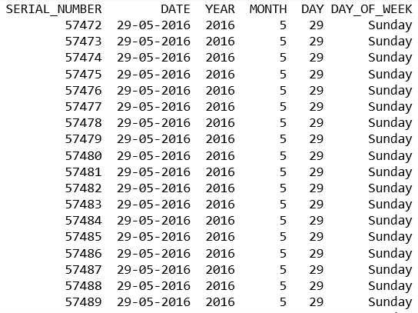
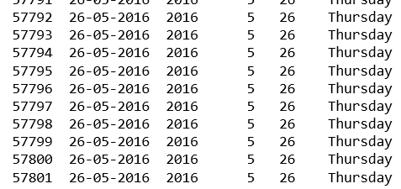
DATA SLICER

Slide 9
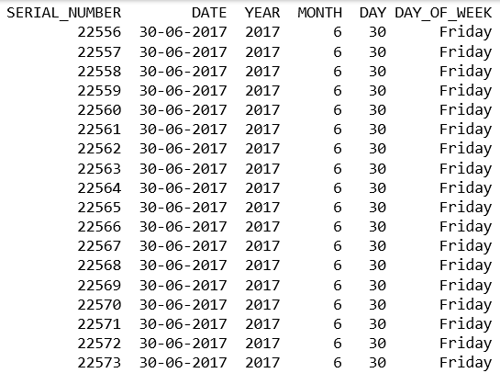
MONTH WISE

Slide 10
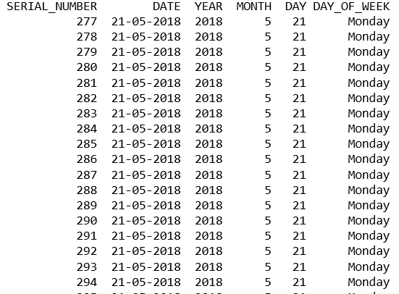
DAY OF THE WEEK

Slide 11
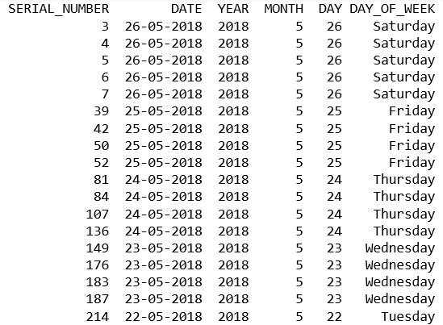
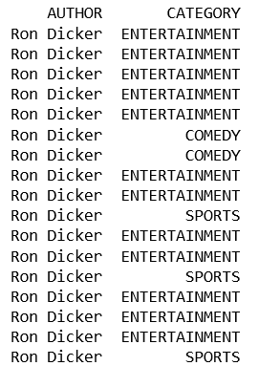
AUTHOR

Slide 12
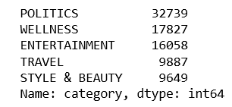
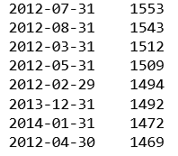

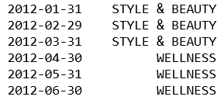
Top 5 Categories
Number of Articles Per Month
Average Number of Articles Per Month
Popular Content Category Each Month

Slide 13
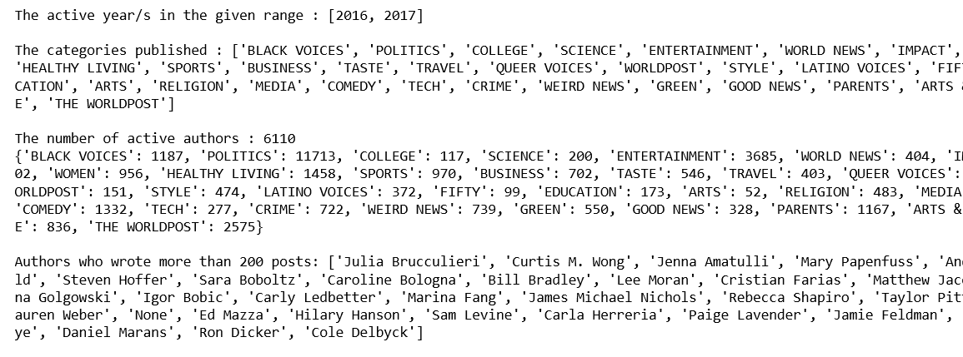
DATE TO DATE ANALYSIS
Input : Start Date and End Date

Slide 14
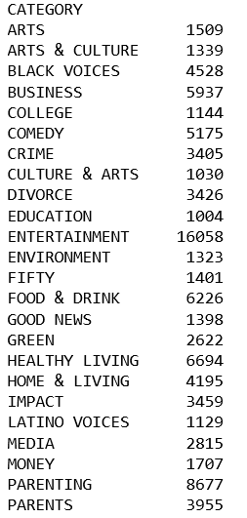

REPORTS

Slide 15
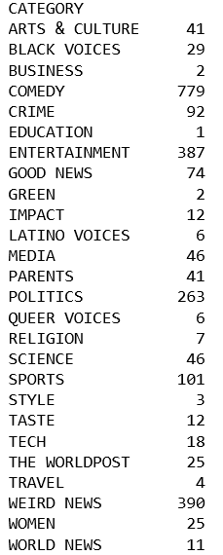
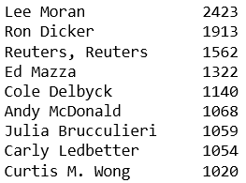
CATEGORIES OF NEWS PUBLISHED BY TOP AUTHOR – LEE MORAN
AUTHOR ANALYSIS

Slide 16
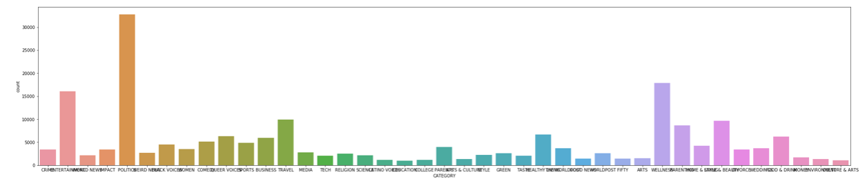
OVERALL COUNTS

Slide 17
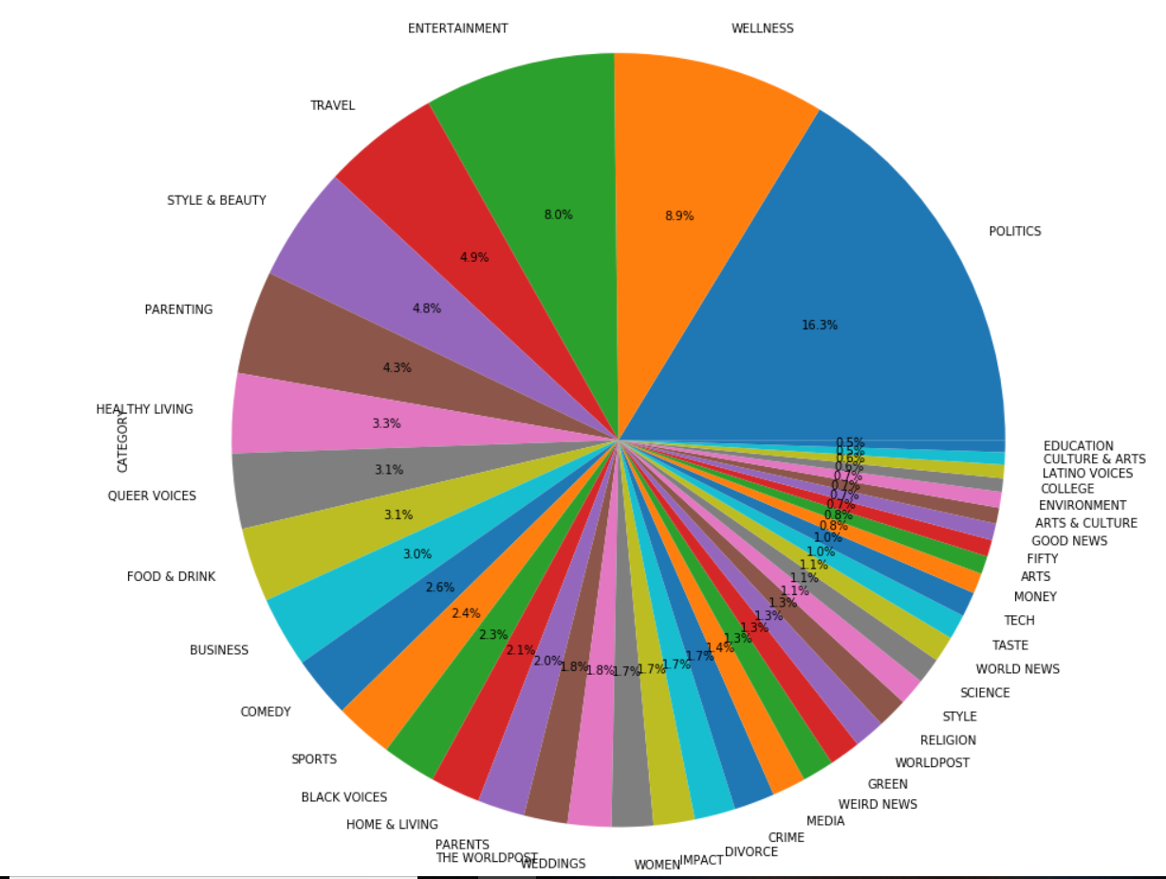
CATEGORY SPLIT

Slide 18
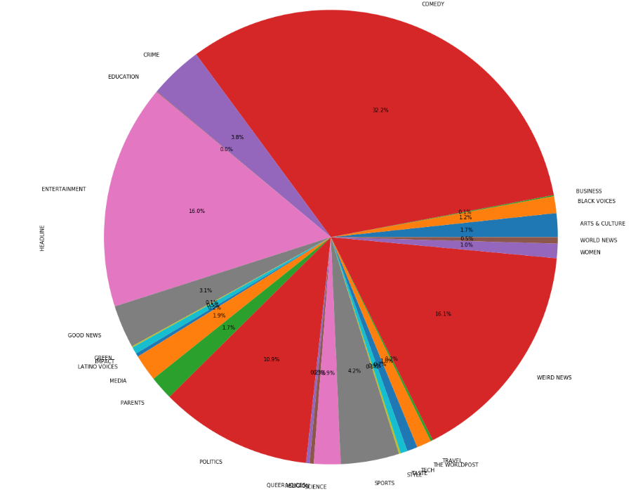
TOP AUTHOR ANALYSIS – LEE MORAN

Slide 19
CATEGORY PREDICTION

Slide 20
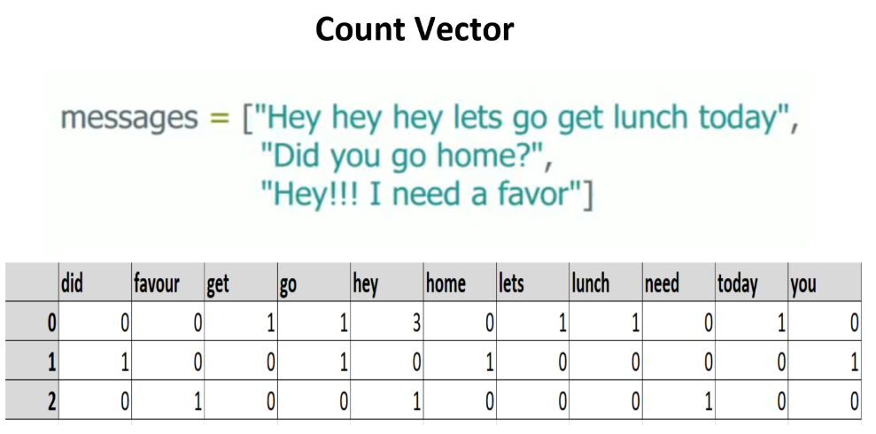
DATA IS CONVERTED TO COUNT VECTORS
WE USE RANDOM FOREST , LINEAR SVC , LOGISTIC REGRESSION

Slide 21
CHALLENGES:
DATA IS TOO LARGE FOR LOCAL SYSTEM.
UNCLEAN.
LESS COLUMNS AND MORE ROWS.

Slide 22
FUTURE SCOPE:
Adding more attributes
Number of reads
Demographic of reads
Tags to each article
Collecting clean data and organizing authors based on inferences of analysis may increase further accuracy

Slide 23
REFERENCES:
https://pypi.org/project/sns/
https://www.kaggle.com/c/news-classification-by-categories

